Slide 1
FIFA 2019 Football Player Value Prediction Project
Description of Data:
# of Observations: 18,207 (17,907 after data wrangling)
# of Features: 88 (55 after feature engineering)
Response: Player Value
Predictors: Demographics, Playing-related, Skill Scores, etc.
Models: Lasso, Elastic Net, Ridge, Random Forest

Slide 2
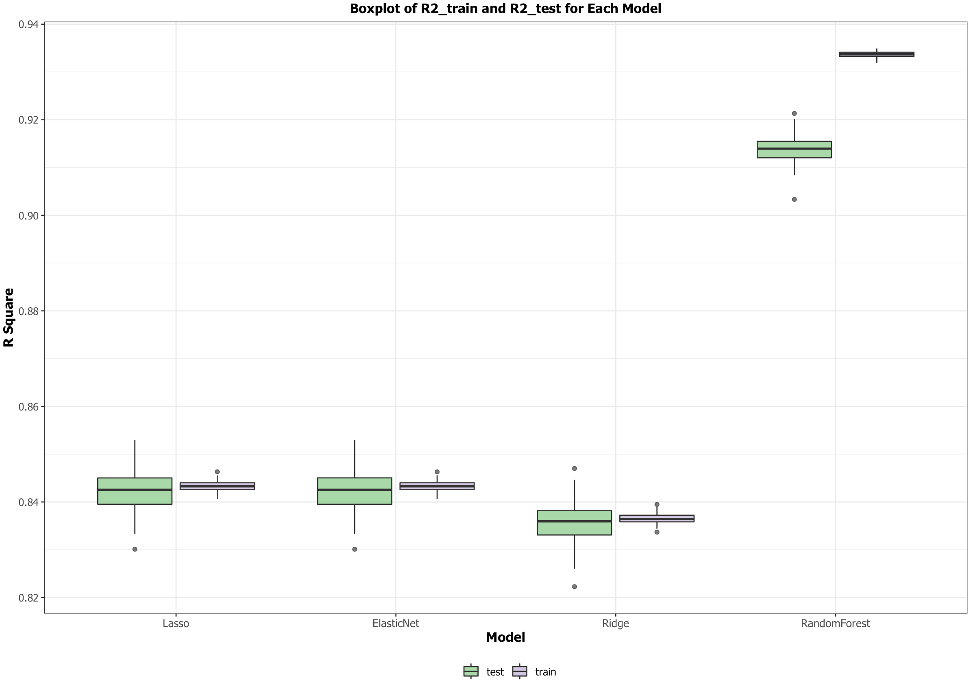
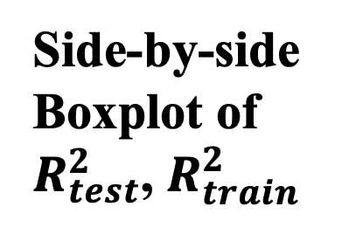
Side-by-side Boxplot of $R_{test}^{2}$, $R_{train}^{2}$

Slide 3
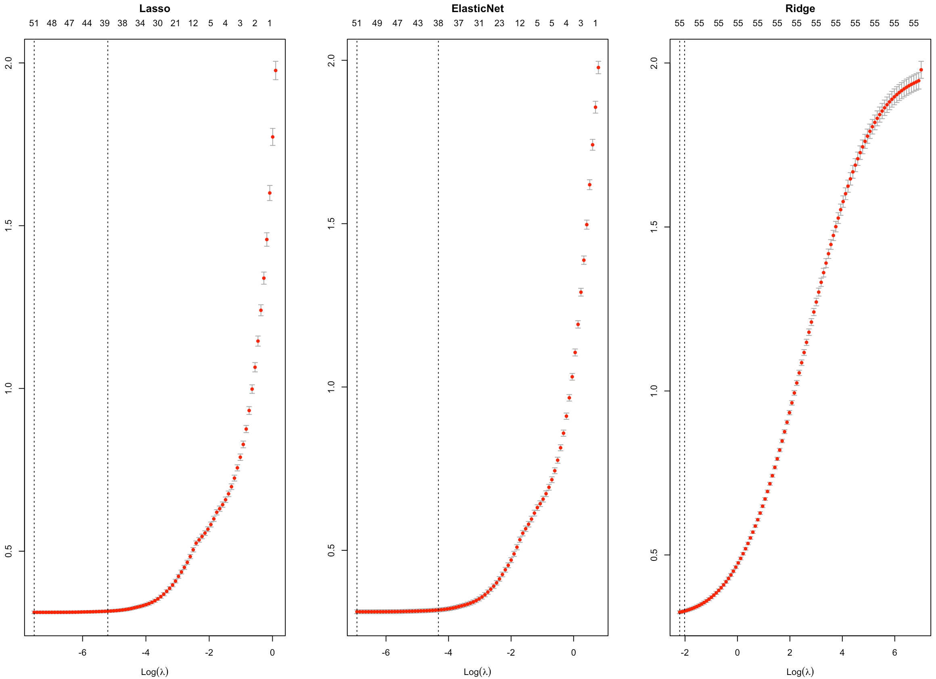
CV Curves for Three Models

Slide 4
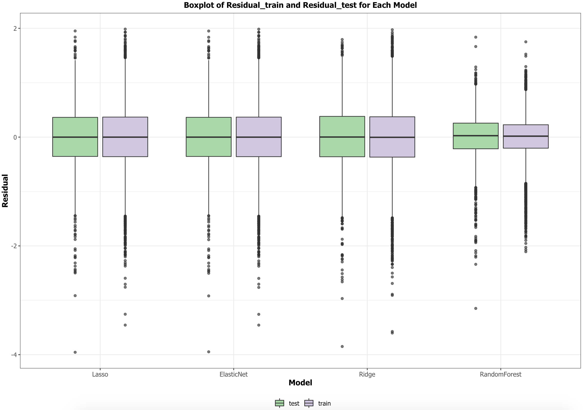
Side-by-side Boxplot of Train & Test Residuals

Slide 5
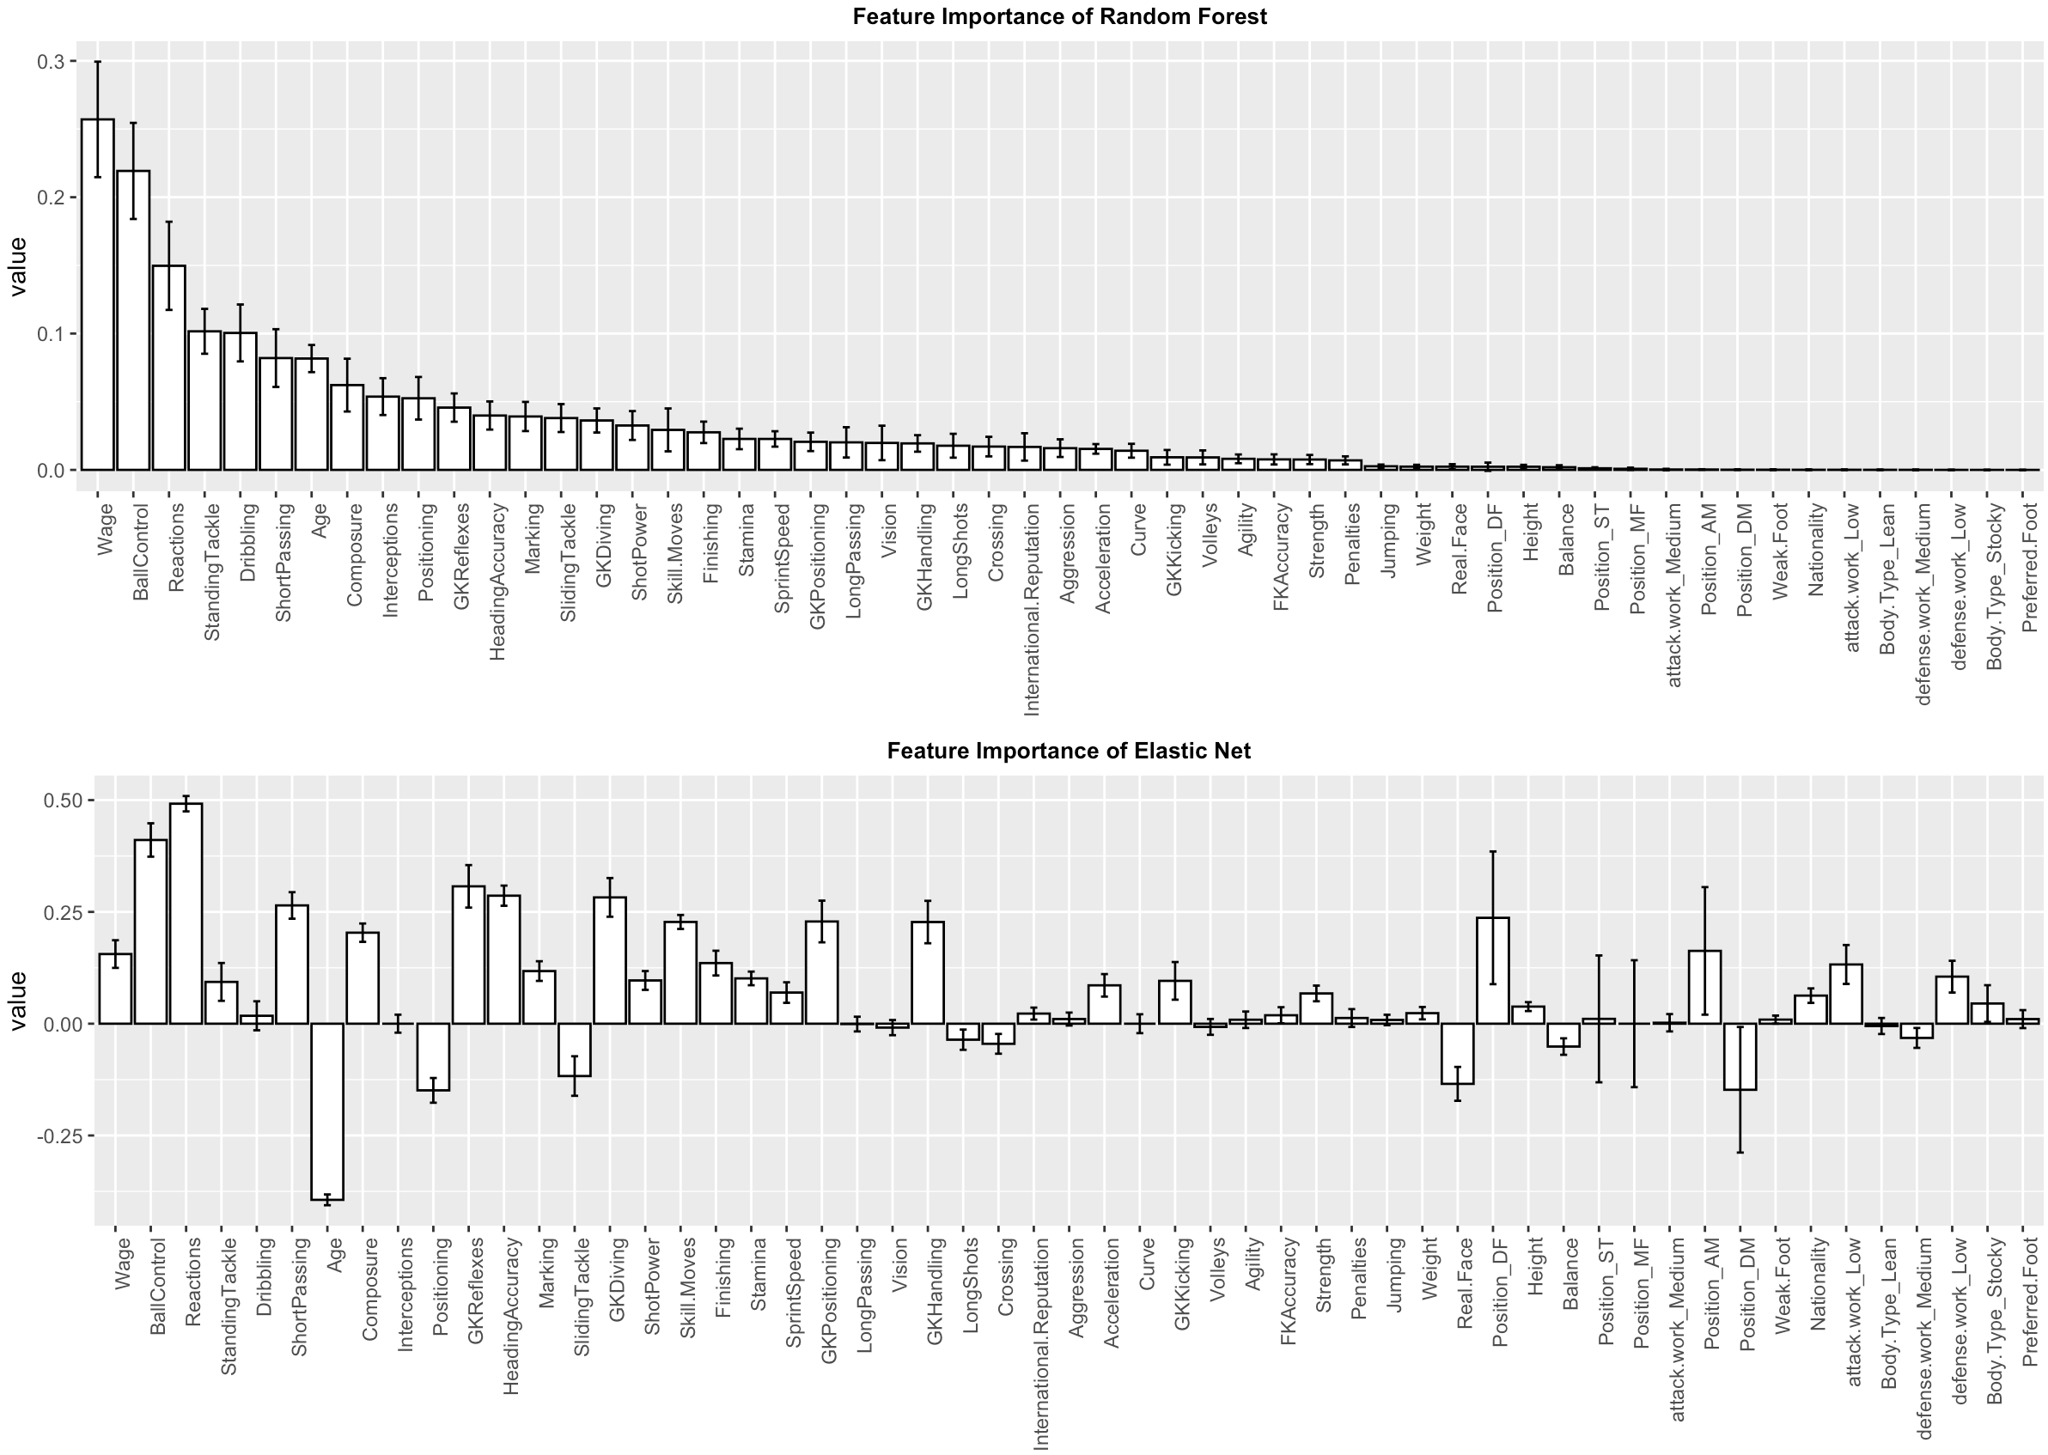
Bar-plots of Estimated Coefficients

Slide 6
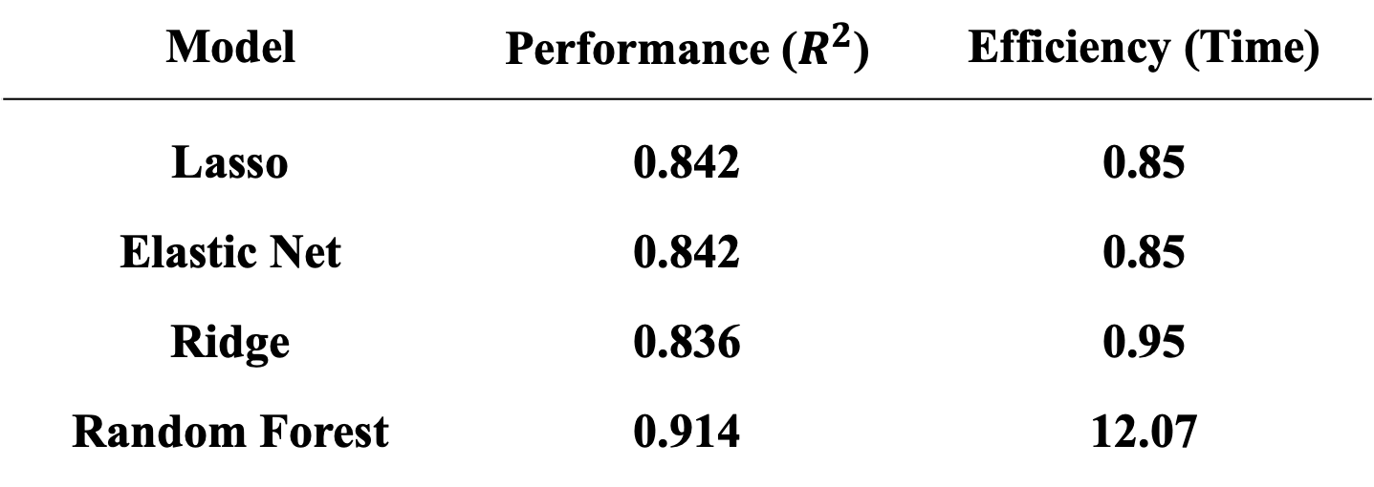
Performance & Efficiency of Models
Model | Performance ($R^{2}$) | Efficiency (Time)
Lasso | 0.842 | 0.85
Elastic Net | 0.842 | 0.85
Ridge | 0.836 | 0.95
Random Forest | 0.914 | 12.07

